Slide 1

Panic Button WIP 2
Sarin Iamsangtham
7/20/2017

Slide 2
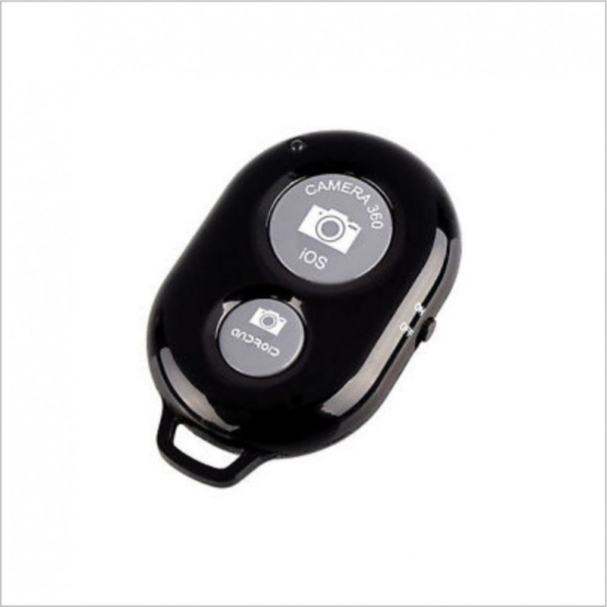
Overview
Objective
Current Features
Changes Made
Current Bugs/Issues
Remaining Tasks
Poster Preview
PANIC
Figure 1: An incredibly rough mockup of the Bluetooth Button for the final product

Slide 3
Objective
To create a personal safety device which
Contacts a list of trusted individuals
Provides information such as last-known-location
Does so at the press (or multiple) of a button
Can be connected to a Bluetooth button

Slide 4
Current Features
Send a customizable message to a specified list of contacts
Optionally send a message containing last-known location
Send the message(s) by pressing one of the following twice within 5 seconds
Volume Up
Onscreen Button
Paired/Connected Bluetooth Button

Slide 5
Changes Made
Layout fixes/adjustments
Ability to change message sent
Rudimentary implementation of Bluetooth Button functionality
Issues fixed with contact display switching around contact information details
Last-known-location message added
Added option to clear all contacts

Slide 6
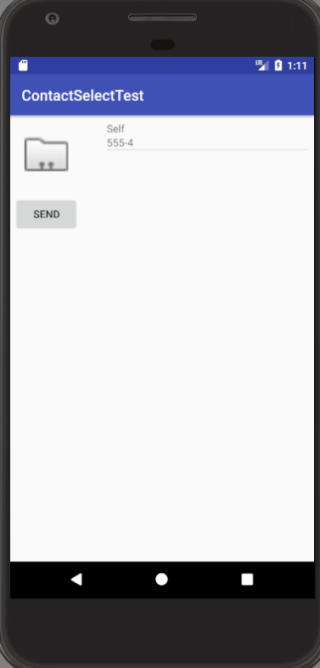
Changes Made
Select Contact
Contacts Listed Here
Click a contact to delete it
Send Message
Figure 2: Screenshot of original prototype

Slide 7
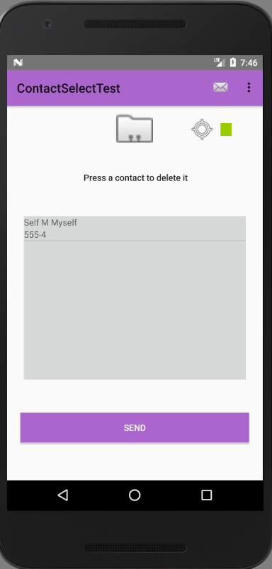
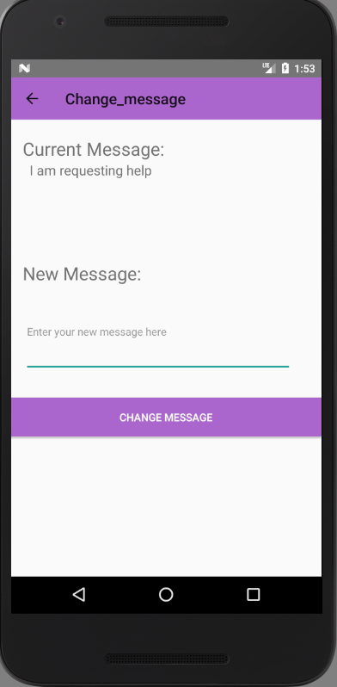
Changes Made
Clear Contact list
Change Message Window
Current Message Display
Toggle location message
Add Contact
Input for New Message
Contact View, tap to delete contact
Confirm message change
Send the message(s)
Figure 3: Screenshots of the updated prototype

Slide 8
Current Bugs/Issues
Layout still somewhat off from Android Studio previews
One error encountered where message would reset to default upon activity switching, but never encountered again since the one time.
Last-known-location not immediately available on app download as expected
Still need to implement contacting authorities

Slide 9
Remaining Tasks
Continue retooling layout
Implement sleep mode functionality if it’s even possible
Implement customization of press count to send messages
Implement other methods of communication
Test range of activation out
Get more feedback on current build

Slide 10
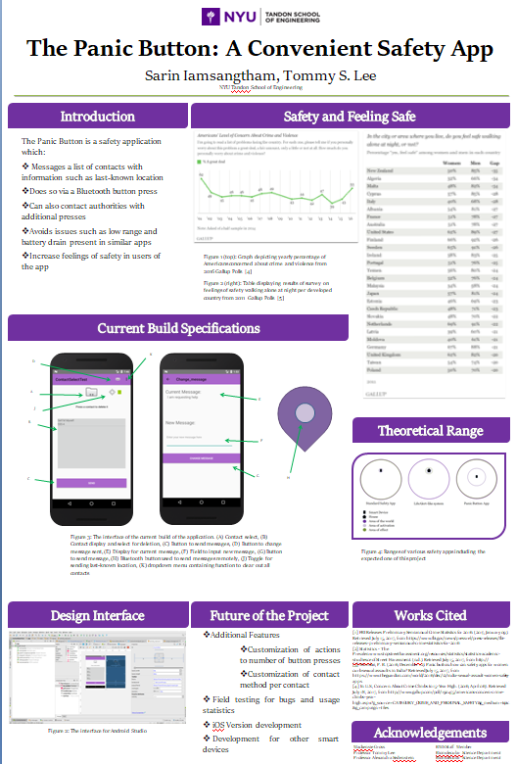
Poster Preview
Figure 4: Poster Draft

